Slide 1
Brazil E-commerce Churn Prediction
Capstone Project - Group 3
Tarun Kishore T. G
Suryaprakash S.M
Ganesh Kumar V

Slide 2
Problem Statement and Dataset Overview
Dataset
Problem Statement
Processes
Brazil E-commerce, OList Store dataset
Customers, orders, purchases, products, and sellers data
Final merged data frame has 21 features and 91832 records
Classify customers based on Churn Rate and assess steps to reduce Churn
Segment customers based on RFM metrics
Increase revenue and customer inflow, while not losing existing customers
EDA to assess the current business.
RFM analysis
Target variable, Churn, creation
Customer Segmentation
Classification Models

Slide 3
Exploratory Data Analysis
Missing Values
Univariate Analysis
Bi and multivariate Analysis
Revenue Analysis
Black Friday Sales
Golden hours for business
Overseas customers
Customer Sentiment

Slide 4
Exploratory Data Analysis - Missing Values
Order Reviews
Orders
Products
order_approved - 160
carrier_delivered - 1783
customer_delivered - 2965
Average time taken for order to get approved [3.93 hours]
Average days an order is in the transit [10 days]
Average days taken for order to get delivered to customer [12 days]
category_name - 610
name_length - 610
description_length - 610
photo_quantity - 610
length, width, height, weight - 2
Product name is masked
Missing value imputation results in falsified data
So missing values are dropped
comment_title - 88.34%
comment_message - 58.70%
Sentiment Analysis is not a scope of this project
Missing values are arbitrarily dropped from the dataset

Slide 5
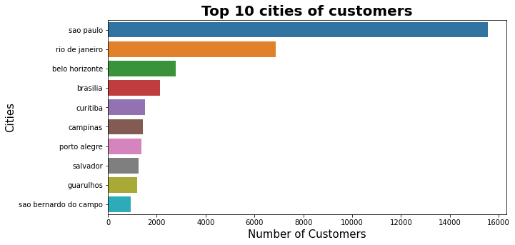
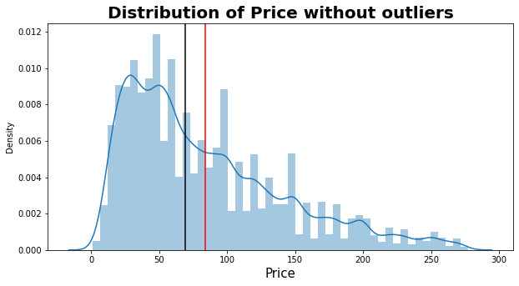
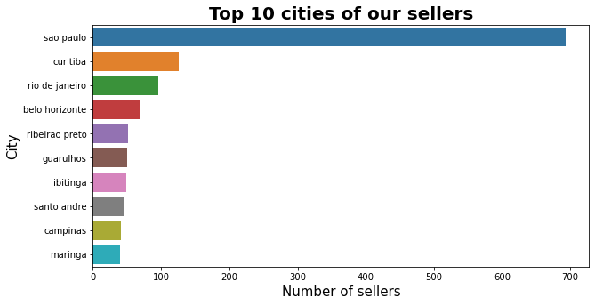
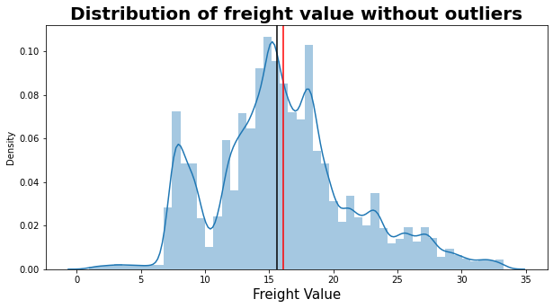
Univariate Analyses

Slide 6
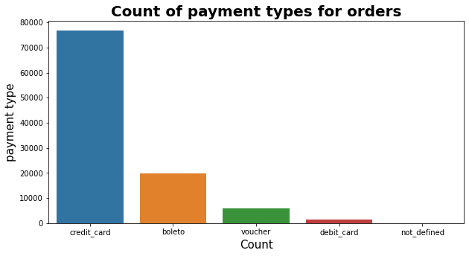
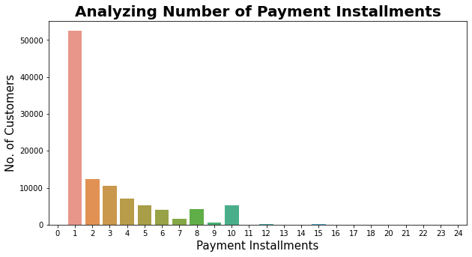
Univariate Analyses
Introduce credit options and installment payment options for high priced products
Product pricing strategy should be optimised and can also apply decoy effect to give options to customers at the same time increase revenue by smaller margins, while customers believe they made a bargain

Slide 7
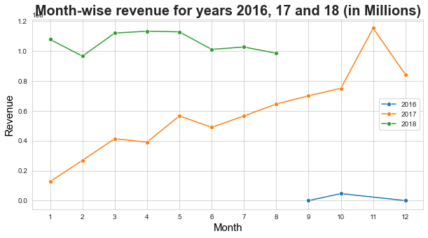
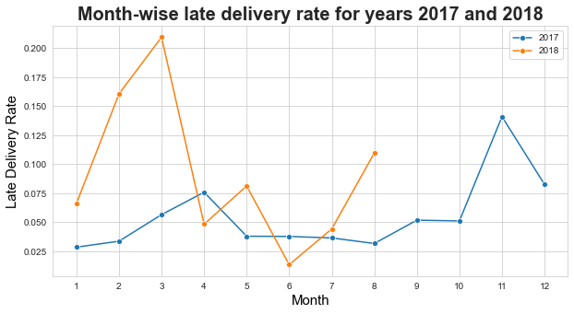
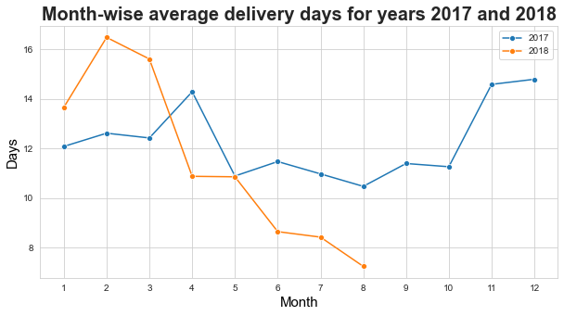
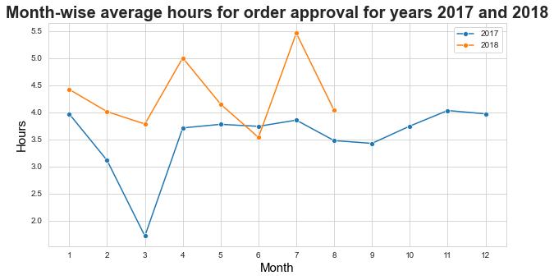
Revenue Analysis and Recommendations
Increase cross-docking centres for first mile delivery
Introduce product traceability
Optimize the inventory management for fast approval of orders
Know target customers and increase their satisfaction

Slide 8
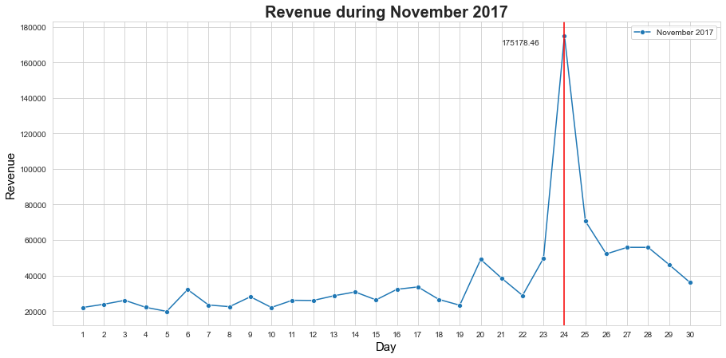
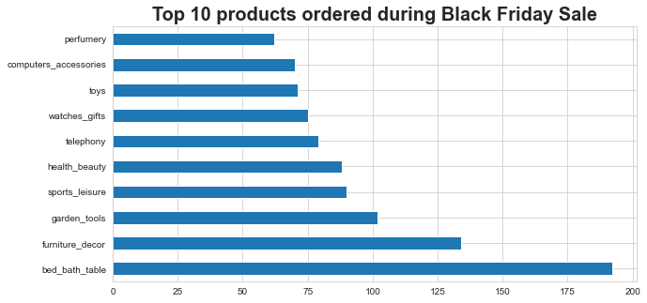
Black Friday Sales and Improvements
Inability to handle huge volume of orders (1147) as 19.33% of orders delivered late compared to an overall 8.12% late deliveries
Increase delivery performance to attract more sales during successive offers
Understand customer preference and market those products extensively

Slide 9
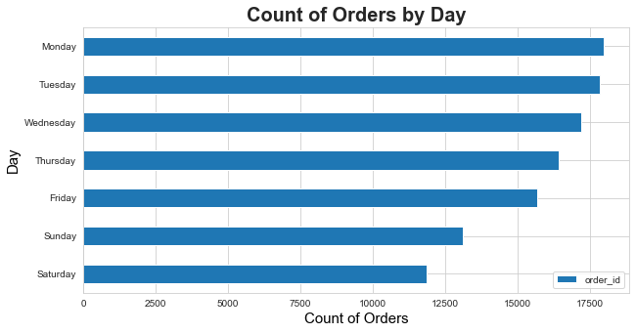
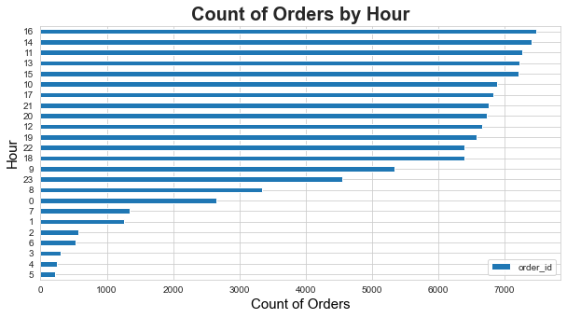
Golden hours for business
Increase weekend sales by strong digital presence and extensive marketing
Attractive offers during peak hour business
Targeting customers through personalised advertisements of products they prefer
Loyal customers benefits and improve customer support

Slide 10
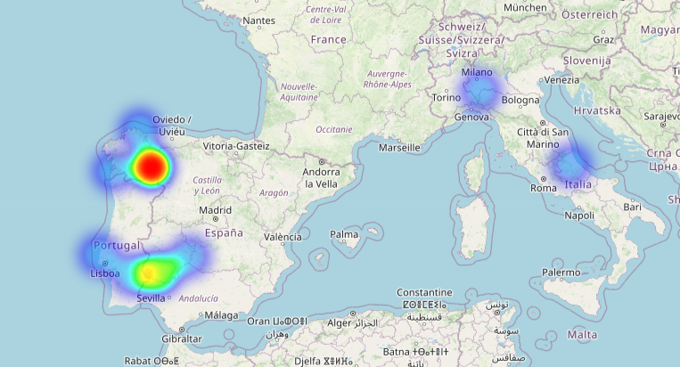
Overseas Customers and Business Expansion
Overseas customers mostly ordered from 2018
More than 50% of orders were delivered late than the estimated delivery date
Very poor shipment delivery rate should be handled by opting for a new logistic partner
Promoting indigenous products especially among overseas customers to increase sales and revenue
Focus on company branding and prominency in the origin region, to help create trust among customers
Focus on CX (Customer Experience) throughout the process of order and offer customer support

Slide 11
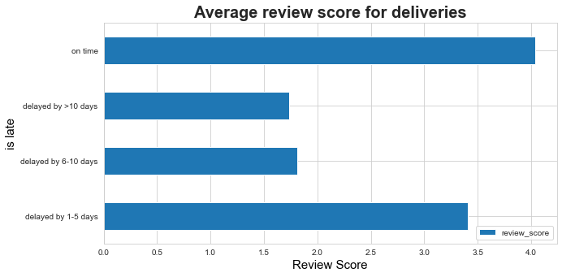
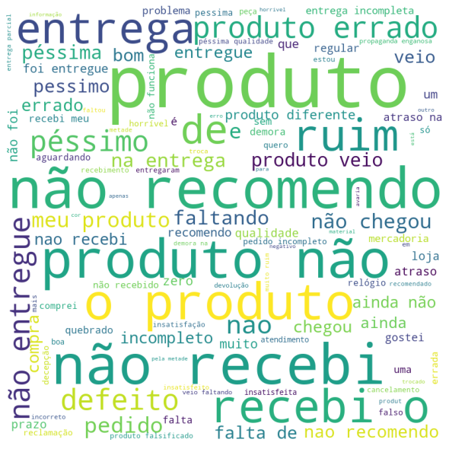
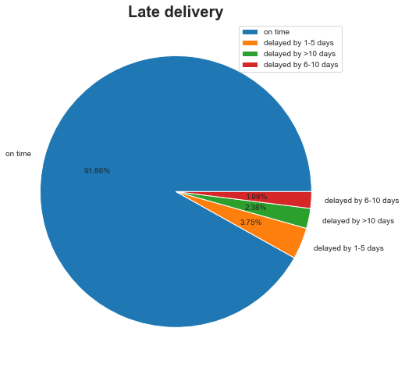
Customer Sentiments
Which translated to - I do not recommend, bad, wrong product, didn’t receive the product, defective product, terrible
Offer free deliveries for orders over a specific amount
Introduce timely customer support
Check for defects before dispatching

Slide 12
RFM ANALYSIS
Introduction to RFM
Order of Importance
Method of Calculation
Logic for RFM
Important RFM Ranks
RFM Insights
Target Variable Creation

Slide 13
RFM Analysis (Recency, Frequency & Monetary)
RFM is a data driven customer behaviour segmentation technique
Goal of RFM is to segment/classify/divide the customers based on
Recency
Frequency
Monetary
All three of these measures have proven to be effective predictors of a customer's willingness to engage in marketing messages and offers.

Slide 14
Order of Importance
Recency > Frequency > Monetary
Recency is the highest because the longer it takes for a customer to return to your business, the less likely he or she is to return at all.
Frequency is second as it measures the intensity of a customer’s relationship with your business. And good customers, by definition, do business with you more often.
Monetary is how much a customer spends on average or in total and it is the final measure of his or her value. It helps distinguish between relatively light and heavy spenders

Slide 15
Methods of Calculation for RFM
Recency
(R)
Recency is calculated by subtracting the last recent date available in the dataset with every customer's last purchase date.
Frequency
(F)
Frequency is calculated by selecting the number of unique order_id or orders placed by each individual customer.
Monetary
(M)
Monetary is calculated by summing up the payment value of each individual customer who placed one or more orders.
In RFM, the order of ranking is 1>2>3>4 where 1 being the highest rank, 4 being lowest rank

Slide 16
Logic for RFM rank
Recency Ranks
1 - These are the customers whose visit date(s) are the most recent. (Recency value within the 25% quantile)
2 - These are the customers whose visit date(s) are not very recent. (Recency value between 25% and 50% quantile)
3 - These are the customers whose visit date(s) are somewhat recent. (Recency value between 50% and 75% quantile)
4 - These are the customers whose visit date(s) are the oldest. (Recency value more than 75% quantile)
Frequency Ranks
1 - These are the most frequent. (Frequency > 3)
2 - These are the frequent. (Frequency = 3)
3 - These are the somewhat frequent. (Frequency = 2)
4 - These are the least frequent. (Frequency = 1)
Monetary Ranks
1 - These are the customers who spend large amounts. (Monetary value within the 25% quantile)
2 - These are the customers who spend a good amount. (Monetary value between 25% and 50% quantile)
3 - These are the customers who spend moderately. (Monetary value between 50% and 75% quantile)
4 - These are the customers who spend the least. (Monetary value more than 75% quantile)

Slide 17
Important RFM Ranks
97% of the frequency values are rank/value 4. For this reason, frequency has been excluded from the RFM analysis and we are instead continuing with RM Analysis.
The most important ranks:
(Recency - 1, Monetary - 1) - They are very recent and have spend a lot of money
(Recency - 1, Monetary - 2) - They are very recent and have spend a good amount of money
(Recency - 2, Monetary - 1) - They are recent and have spend a lot of money
(Recency - 2, Monetary - 2) - They are recent and have spend a good of money
(Recency - 1, Monetary - 3) - They are very recent and have spend a decent of money
The least important ranks:
(Recency - 4, Monetary - 4) - They are not at all recent and spend a negligible amount of money
(Recency - 4, Monetary - 3) - They are not at all recent and spend a decent amount of money
(Recency - 4, Monetary - 2) - They are not at all recent and spend a good amount of money
(Recency - 3, Monetary - 4) - They are not very recent and spend a negligible amount of money
(Recency - 3, Monetary - 3) - They are not very recent and spend a decent amount of money

Slide 18
Insights from RFM
Insights from Recency Ranks:
Customers can be incentivised to purchase more in our store using offers/discounts/events which will make them more recent and at the same time bring in more money
Customers will use our store if the website is user-friendly and quick. This will help make the customer's shopping experience smooth meaning they will continue coming back to our store/website for their purchasing needs

Slide 19
Insights from RFM
Insights from Monetary Ranks:
Customer's monetary values can be increased with a better algorithm which will recommend similar/useful items when an item is added to cart
What are the Steps can be Done to Improve:
Local language can be used in the ecommerce platform/store
Extend special offers for repeated purchases
Encourage Loyalty programs
Lower the Product Pricing for Increased Customer Frequency

Slide 20
Target Variable Creation
Churn is the target variable, which is created using the Recency feature.
Recency values which are greater than the mean recency are marked as churned.
The recency values which are less than that of the mean recency is marked as not churned.
Churn Value 1 = Customer is Churned
Churn Value 0 = Customer is not churned

Slide 21
Model Building
Steps in Model Building
RFE
Hypertuning
Final Model

Slide 22
Built 8 number of models using various algorithms
Logistic Regression (statsmodels) - 0.45
Decision Tree - 0.63
XGBoost - 0.766
RandomForestClassifier - 0.68
KNN (2 clusters) - 0.30
KNN (3 clusters) - 0.54
Logistic - 0.44
GaussianNB (Naive Bayes) - 0.44
We preferred the Test_Recall as the metrics over here. Even though the class is balanced we went for Test_Recall metrics to known the proper count of the customer who have actually churned.

Slide 23
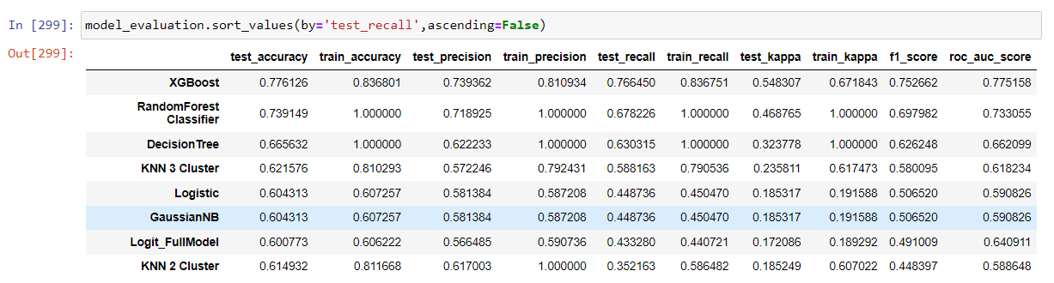
Model Building

Slide 24
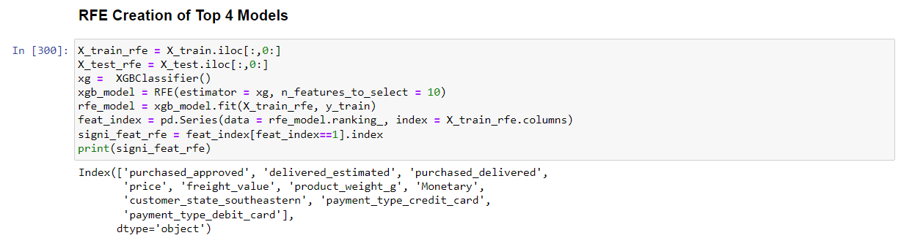
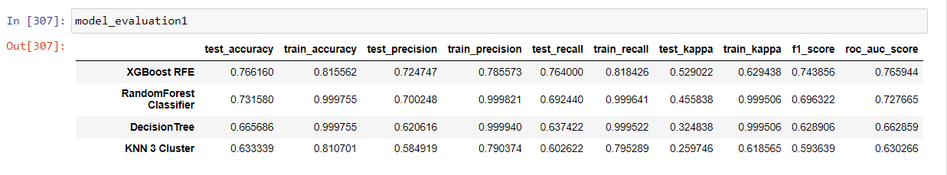
Top 4 Performing Models

Slide 25
Top 4 Performing Models
Found the 4 top performing models (based on Test Recall)
XGBoost - 0.76
RandomForestClassifier - 0.68
Decision Tree - 0.63
KNN (3 clusters) - 0.54
There the top 2 Model are XGBoost and Random Forest are tuned and again model is built.

Slide 26
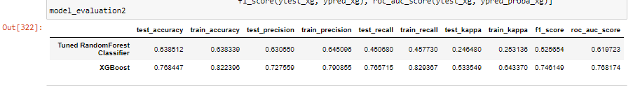
Model Tuning

Slide 27
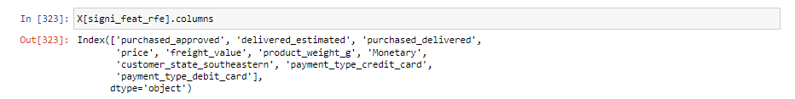
Top Columns from the XGBoost Model

Slide 28
Model Evaluation
Objective of model - The objective of the model is to predict whether a customer is churned or not
Top model name - XG Boost (Hypertuned)
Main metric we looked at was Recall as our goal is to minimize the false negatives (customers who have churned but are classified as not churned). Other parameter are Accuracy, F1 score, Precision and AUC-ROC
Train_recall - 0.829
Test_recall - 0.765
Train_accuracy - 0.822
Test_accuracy - 0.768
Train_precision - 0.79
Test_precision - 0.727
Train_kappa - 0.643
Test_kappa - 0.533

Slide 29
Business Insights
Customer visiting days:
More customers visit the website on weekdays rather than weekends which is quite odd.
In this case we can increase the offers only limited to the weekends and advertise these inorder to attract customers during the weekends
Customer visiting hours:
The hours which customers visit more often should be targeted with ads and when they are not visiting, the ads should be reduced or fully removed
Logistics system:
Quarterwise report showed that Q1 and Q2 sales for 2018 are much higher than Q1 and Q2 sales in 2017 which is due to increased efficiency of the logistics system of the company
Logistics system of the company can be improved, mainly for days of high sales like Black friday
Reviews:
Business needs to improve their logistic system and overall shopping experience (website speed,offers,discounts,easy user interface) when possible so that customers don’t post bad reviews and at the same time will be satisfied and post good reviews

